Slide 1
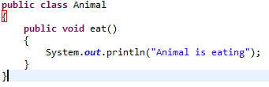


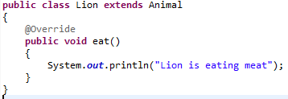
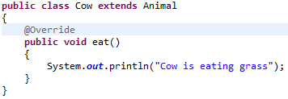
Method Overriding
If subclass (child class) has the same method as declared in the parent class, it is known as method overriding in java.
In other words, If subclass provides the specific implementation of the method that has been provided by one of its parent class, it is known as method overriding.
Method overriding is used to provide specific implementation of a method that is already provided by its super class.
Method overriding is used for runtime polymorphism.
extends
extends

Slide 2
Method Overriding
Method must have same name as in the parent class.
Method must have same number and the type of its parameters as in the parent class.
Method must have same return type as in the parent class.
Must be IS-A relationship (inheritance).
When overriding a method, you might want to use the @Override annotation that instructs the compiler that you intend to override a method in the superclass. If, for some reason, the compiler detects that the method does not exist in one of the superclasses, then it will generate an error.
The ability of a subclass to override a method allows a class to inherit from a superclass whose behavior is "close enough" and then to modify behavior as needed. The overriding method has the same name, number and type of parameters, and return type as the method that it overrides. An overriding method can also return a subtype of the type returned by the overridden method. This subtype is called a covariant return type.

